Slide 1
Erasmus 2023 POLSKO
Zemědělská akademie a Gymnázium Hořice
- střední škola a vyšší odborná škola, příspěvková organizace

Slide 2
Goal of our journey
Discover new technologies and elements in teaching
To enrich yourself with foreign culture
Visit most known monuments of the region
Introduce the Czech Republic and it‘s culture to polish citizens

Slide 3
Dąbrowa Górnicza
Zespół Szkolno-Przedszkolny nr 5 w Dąbrowie Górniczej
Elementary school and Kindergarten
Centrum Kształcenia Zawodowego i Ustawicznego w Dąbrowie Górniczej
Secondary school with over twenty professions possible to study

Slide 4
Day 1: Visit of the elementary school
We have visited the elementary school and were integrated into lessons in order to see different approaches to teaching.
Furthermore we have experienced the Polish school canteen with typical meals of Poland nation.
Our students lead the presentation containing basic information concerning the Czech Republic and the town of Hořice.

Slide 5
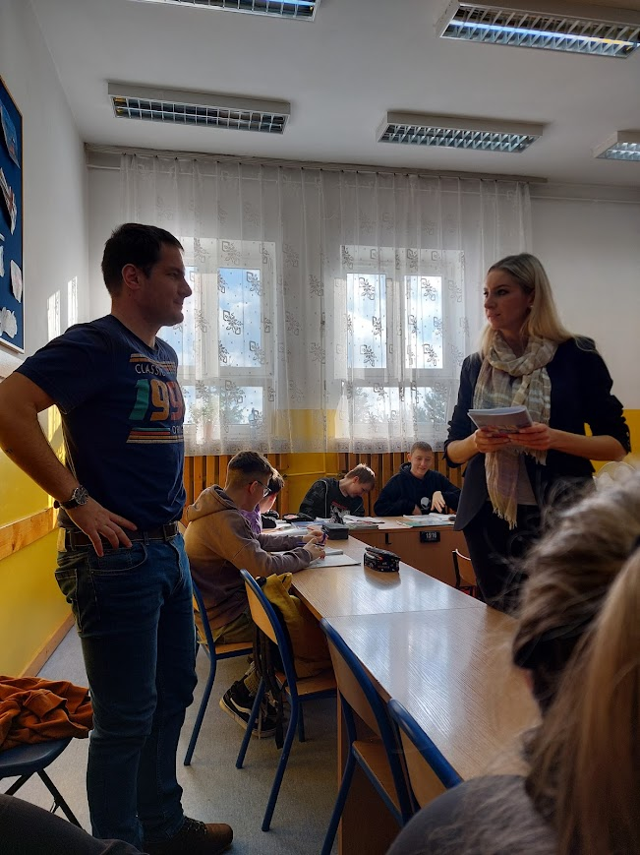
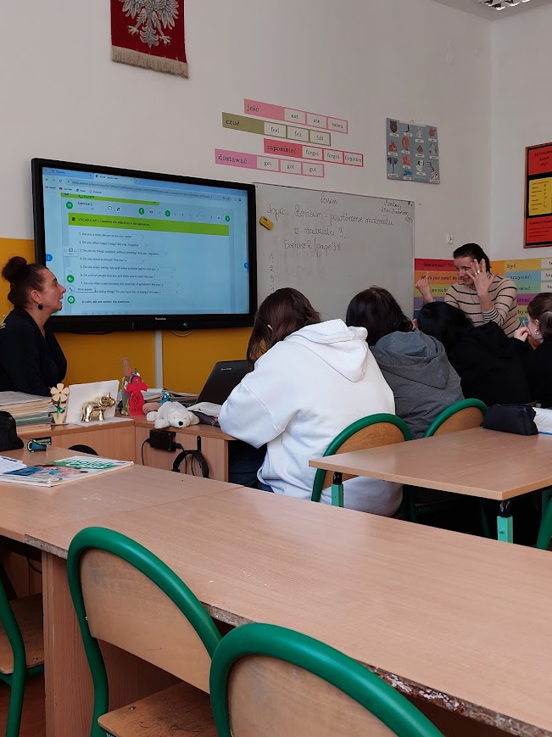

Slide 6
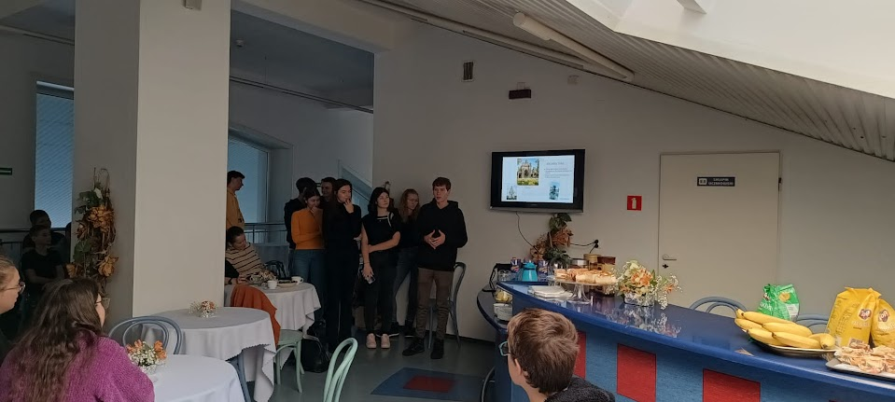

Slide 7
Day 2: Salt mine Wieliczka and the historic city of Krakow
We have seen the depths of the mine (including the life of workers in the previous ages) and the magnificent minerals mined there.
For the second part of the day, we planned a visit to the historic city of Krakow. Using the ActionBound application we prepared an adventure game, during which students experienced the city with all of its glory.

Slide 8
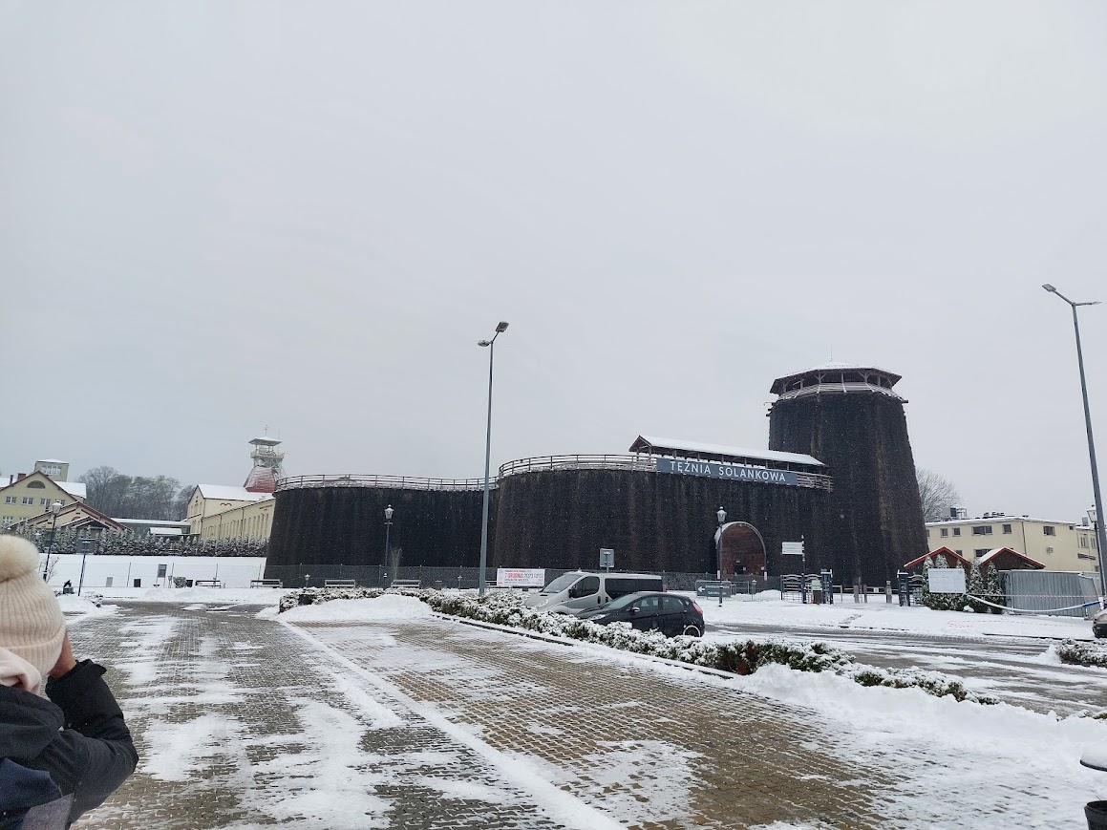

Slide 9
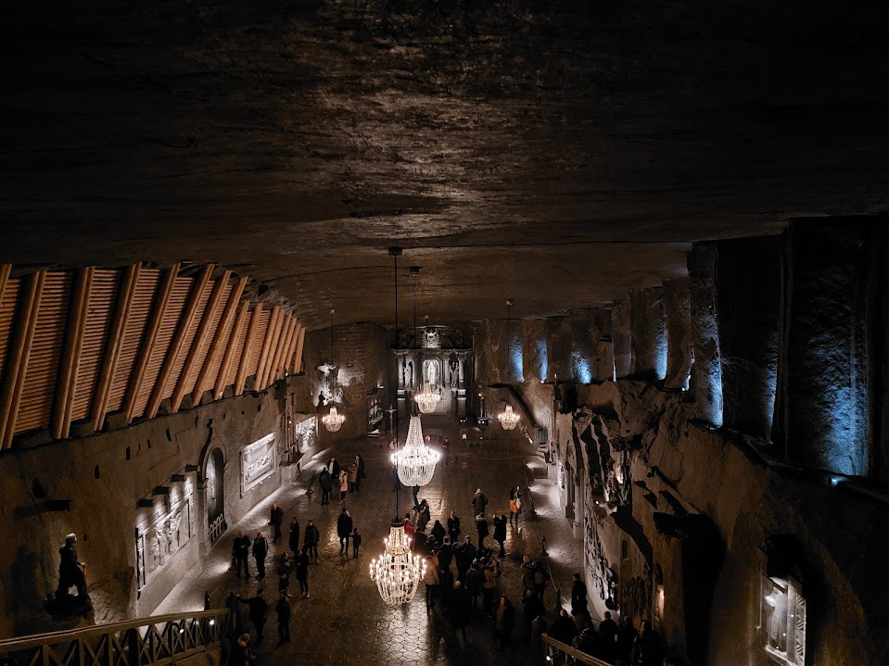

Slide 10
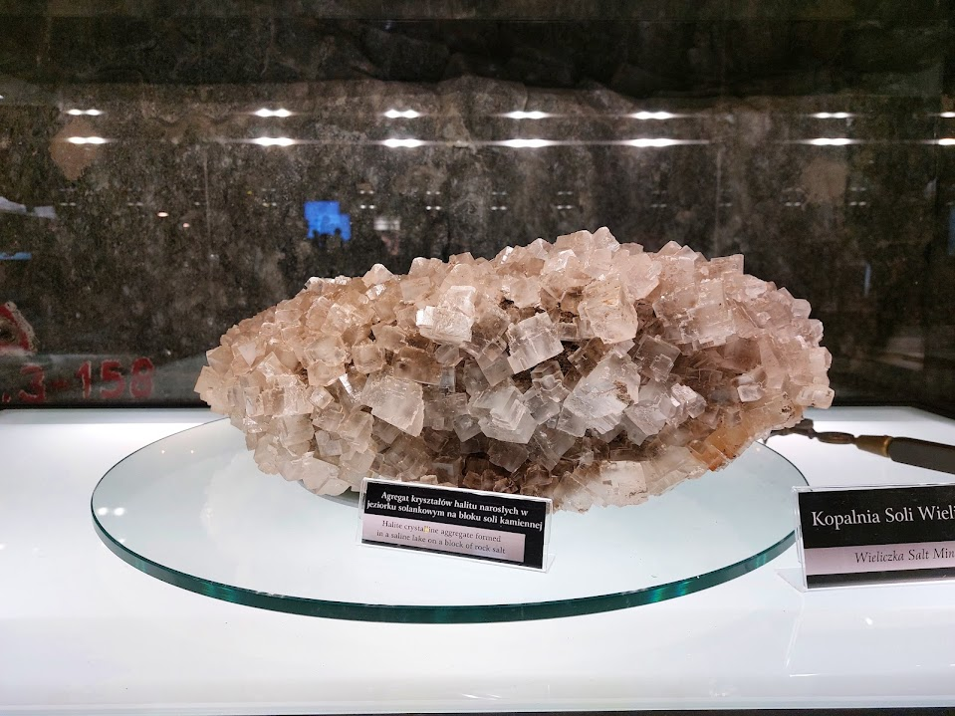

Slide 11
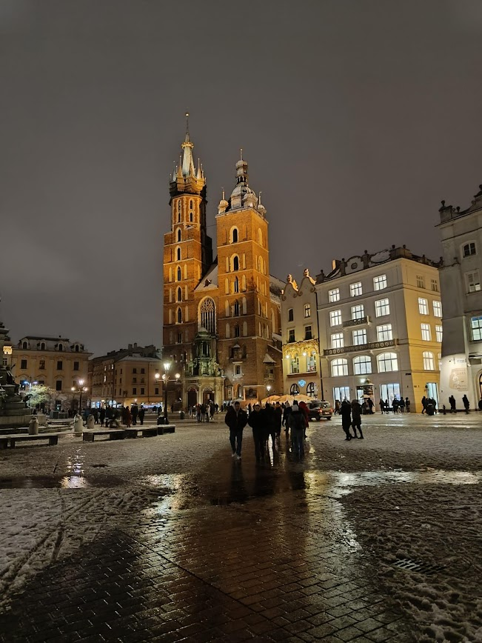
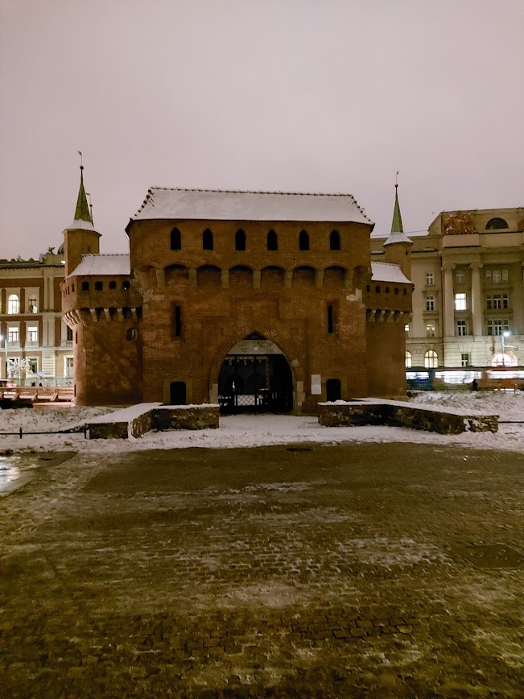

Slide 12
Day 3: Visit of the secondary school and Theatre
Our group was guided through the school complex with a showcase of all of their special classrooms dedicated to a variety of professions.
We were introduced to the most common meals in Poland via a memorization video/game.
Our students participated in one of the cooking lessons and prepared a typical Polish meal.
The director of the school arranged a guide in theatre. The lecture familiarised us with the architecture of the building and events being held there.

Slide 13
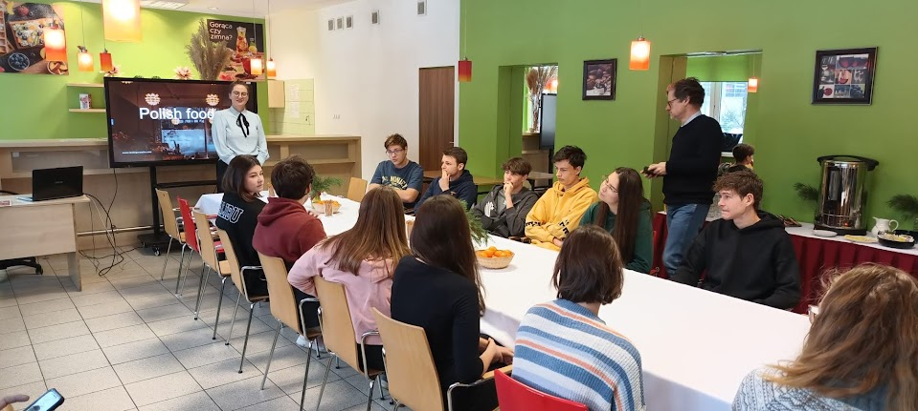

Slide 14
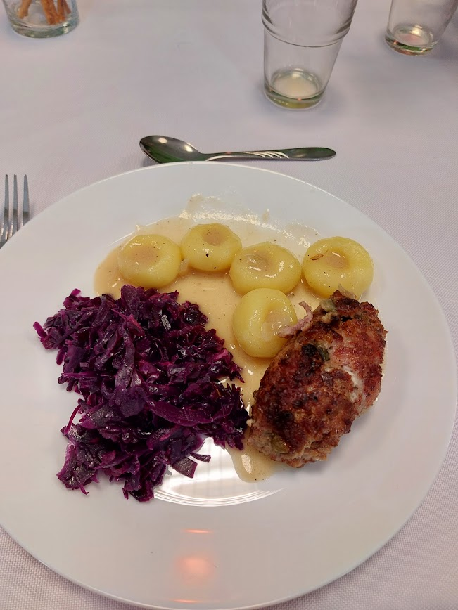
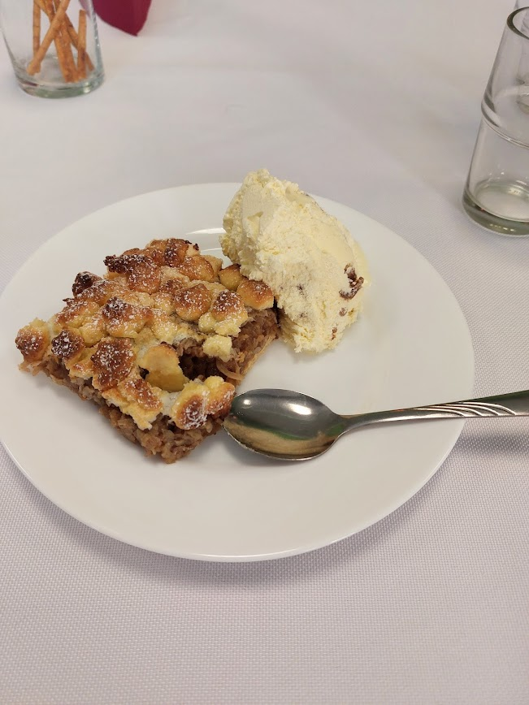

Slide 15
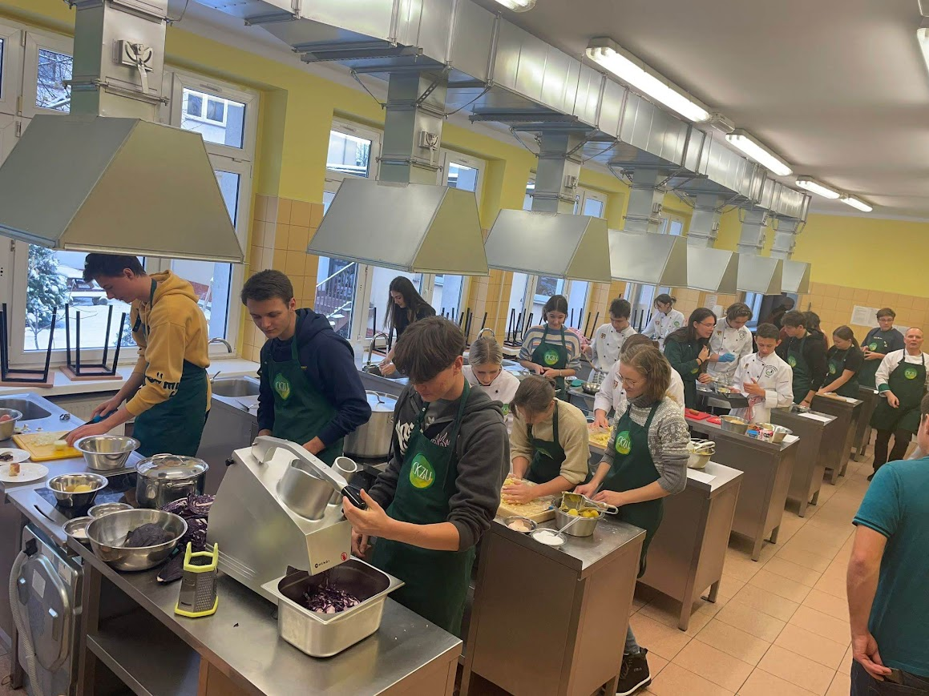

Slide 16
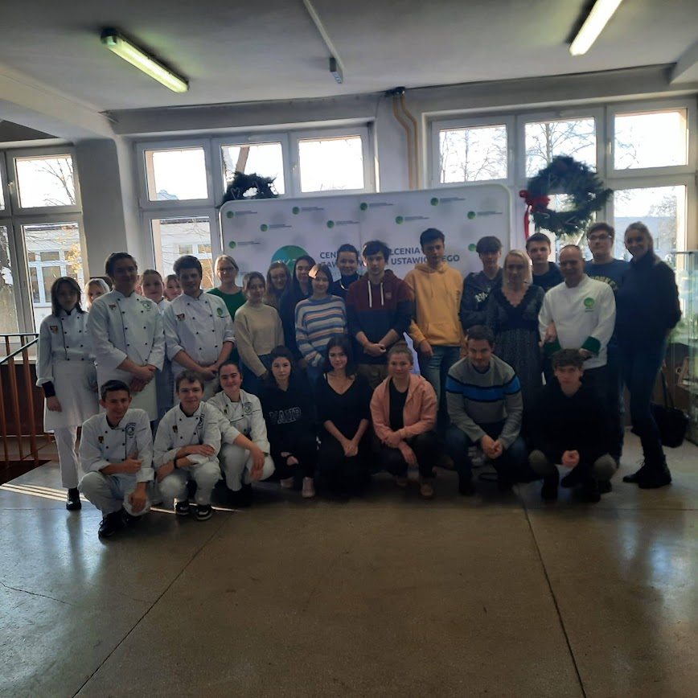

Slide 17
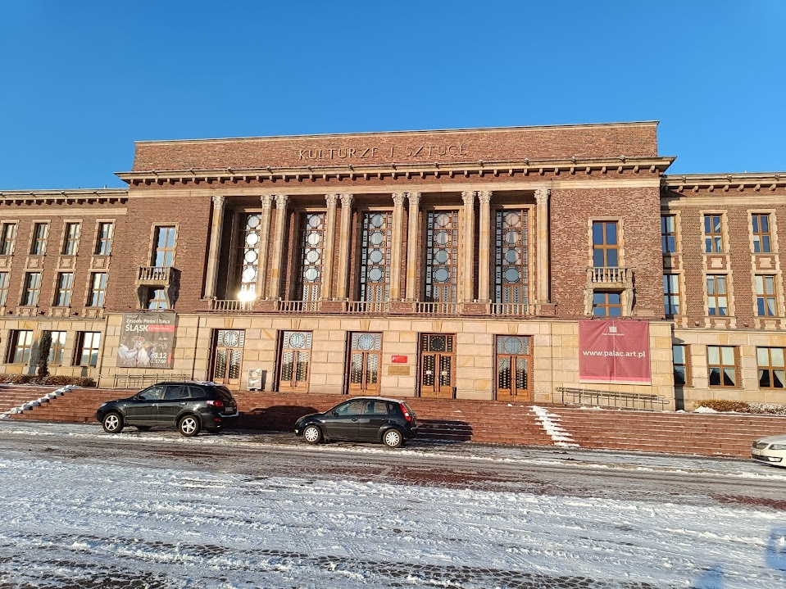

Slide 18
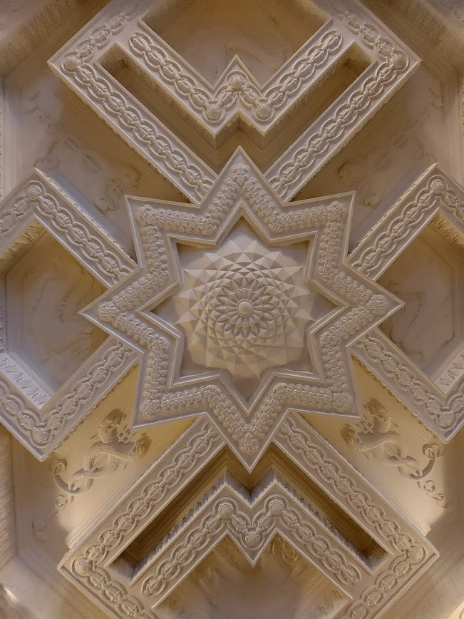
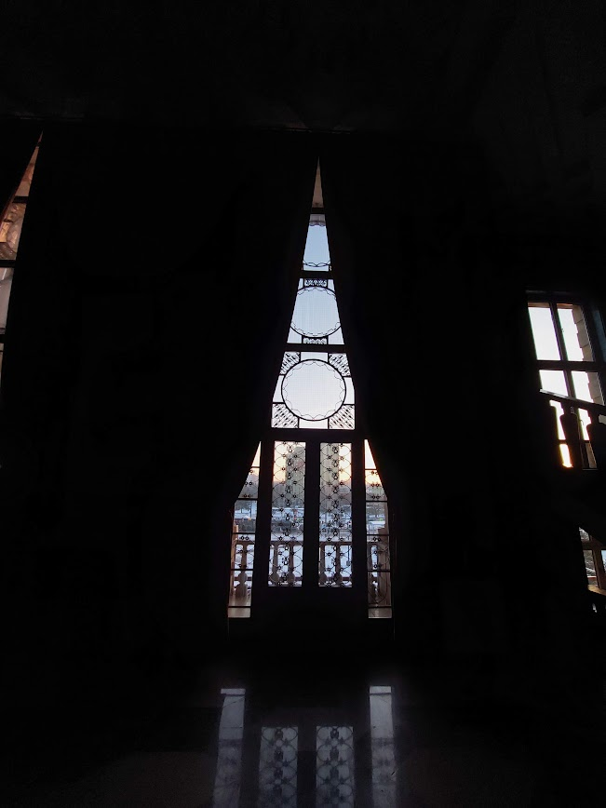

Slide 19
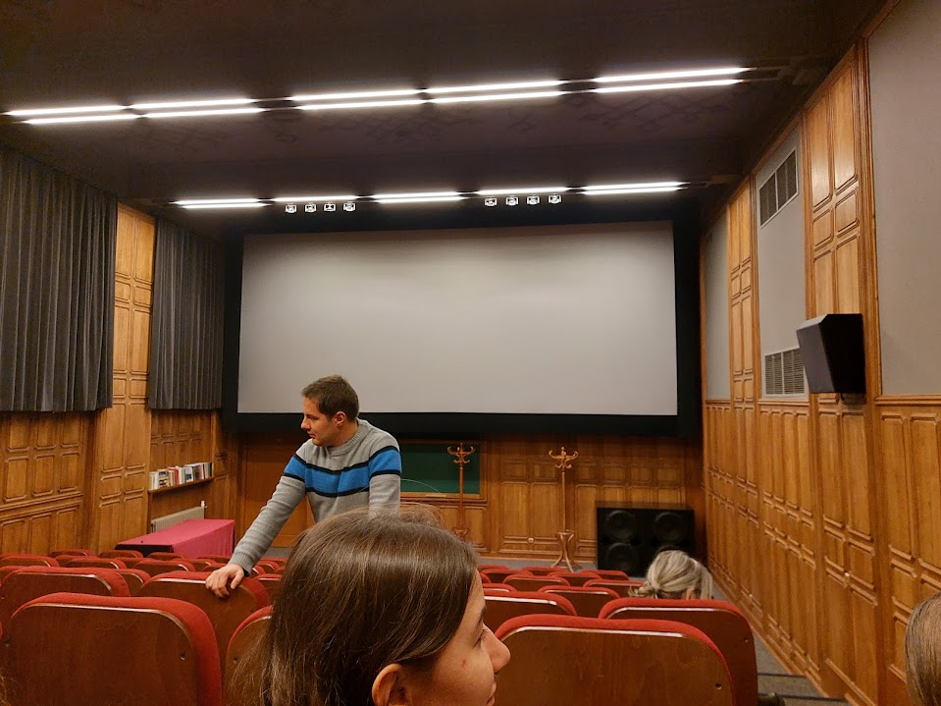

Slide 20
Day 4: Katowice
On the opposite to the historic city of Krakow, we have also visited the more modern city of Katowice.
We have experienced the city with many monuments and also modern buildings.
During our excursion was also a Christmas market held there

Slide 21
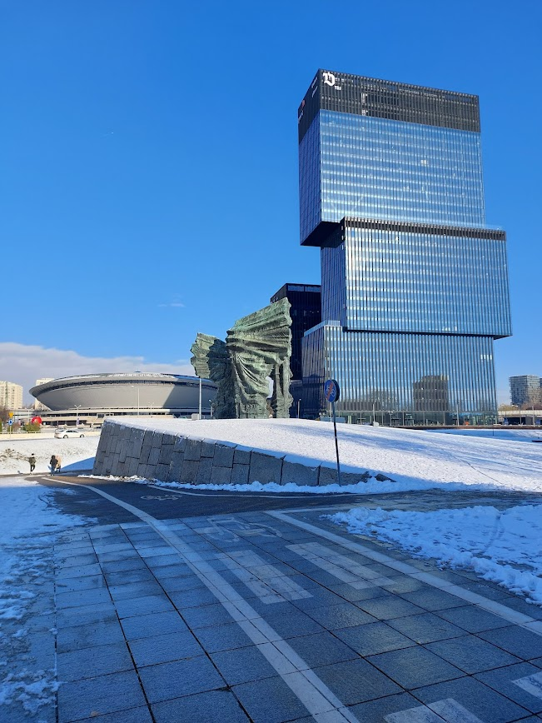
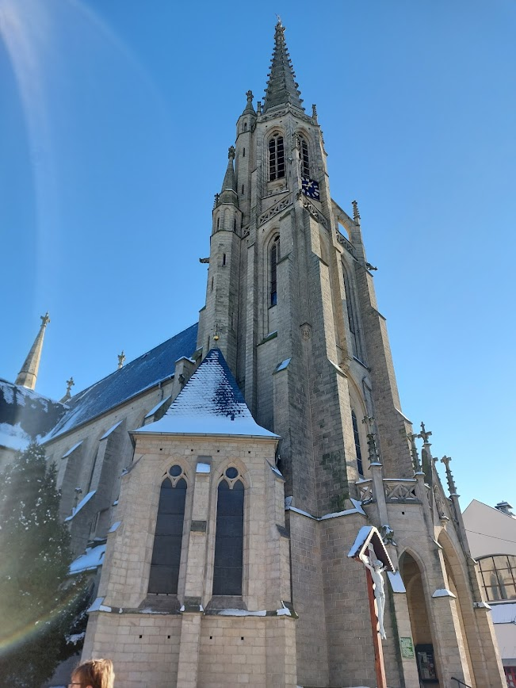

Slide 22
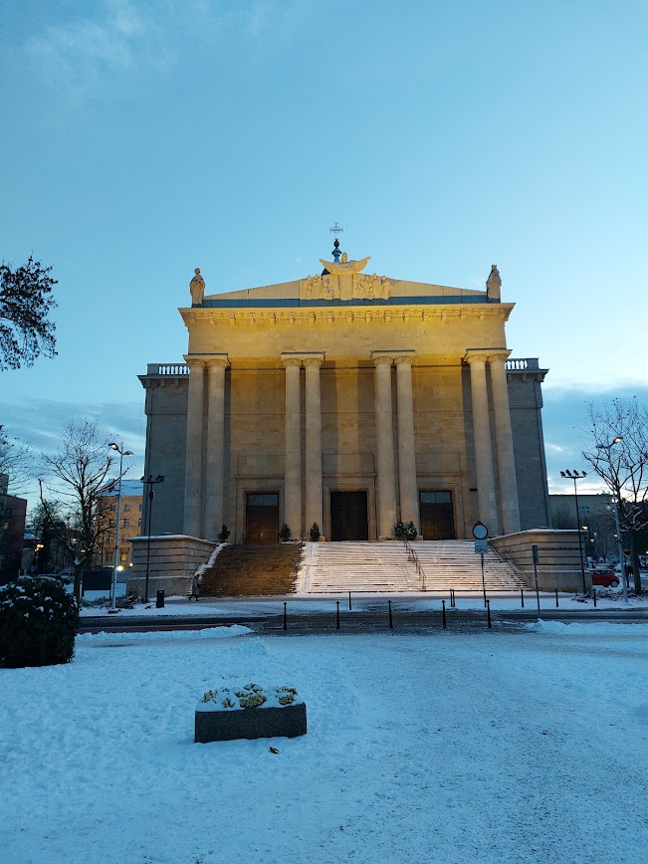
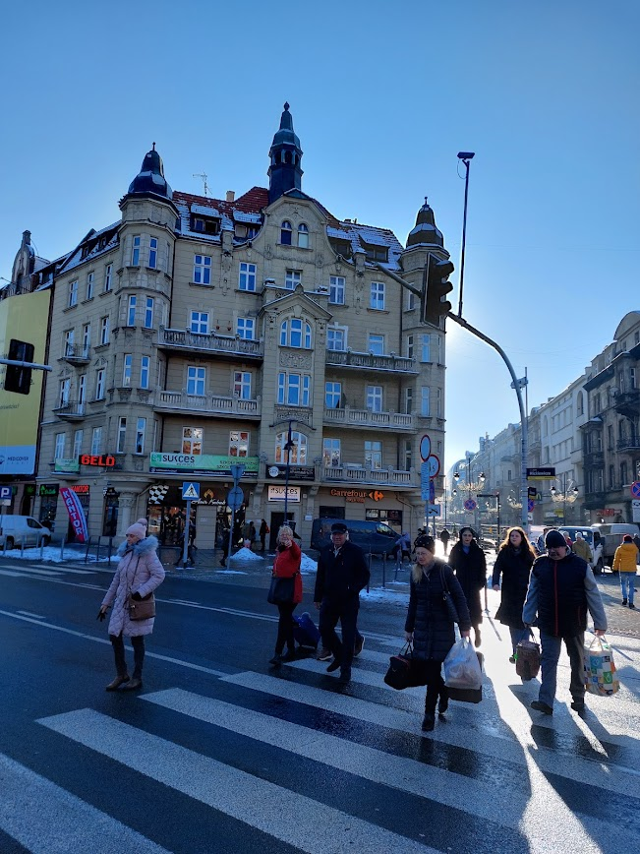

Slide 23
Day 5: Again in elementary school
On our last day in Poland, teachers from the school prepared a theatre play for us and also for all the pupils of their school. The play started with a speech supporting international friendship and seeing citizens of other states as they would be the same nationality as you are.
After tremendous applause following the play, we were shown different modern approaches to education. For example VR reality, LEGO educational sets, usage of camera and greenscreen, robots controlled via mobile phones, and many more.

Slide 24
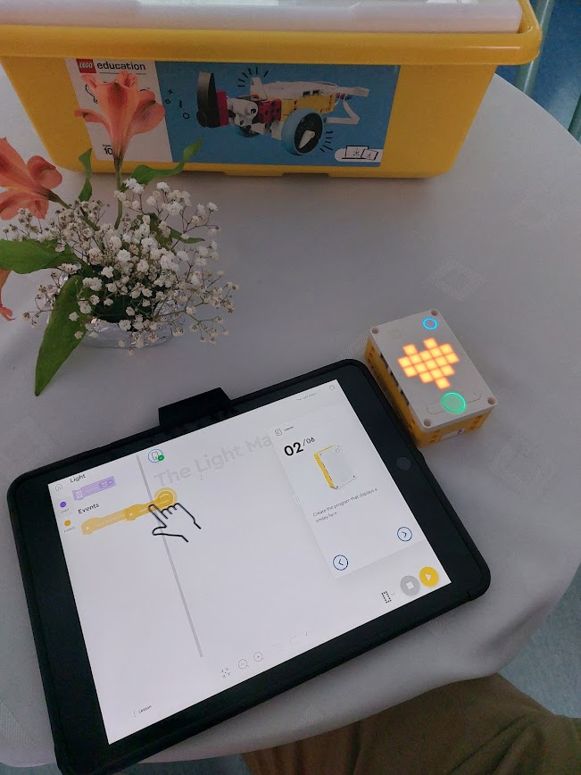
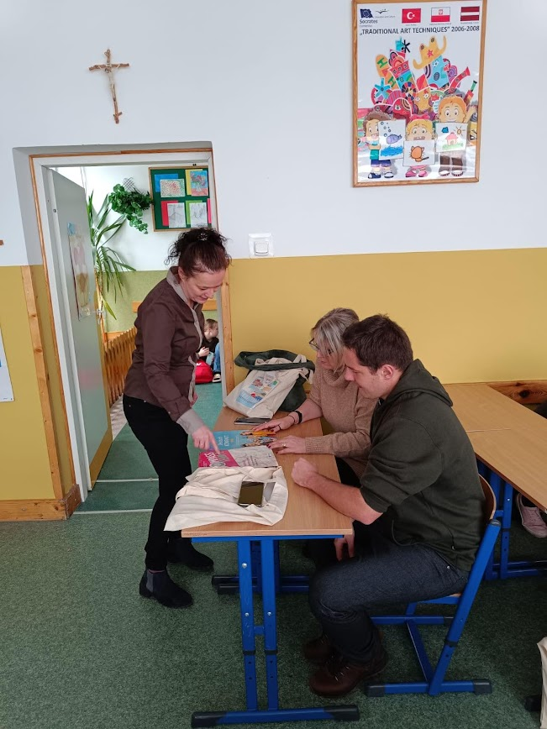

Slide 25
OUTCOMES
ActionBound
Web 2.0 Tools
Application of VR (Virtual Reality) in teaching
LEGO Education – SPIKE Prime – a programmable set of basic and special electronic Lego blocks
Utilization in IT or mathematics lessons

